Slide 1
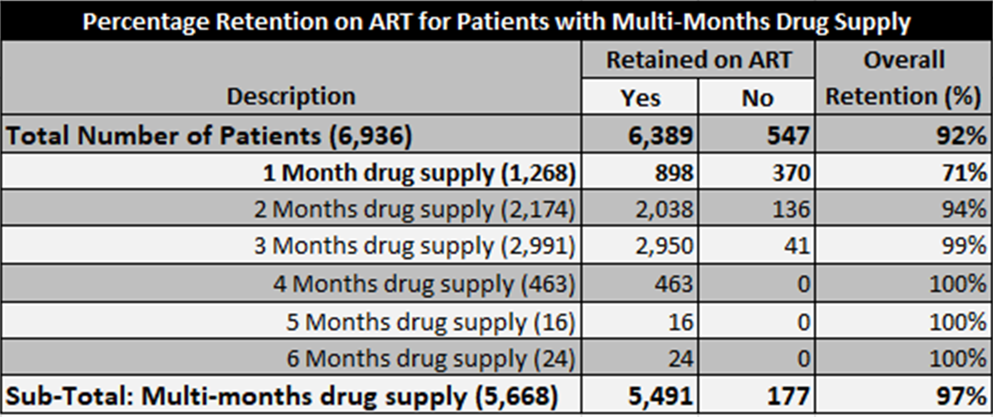
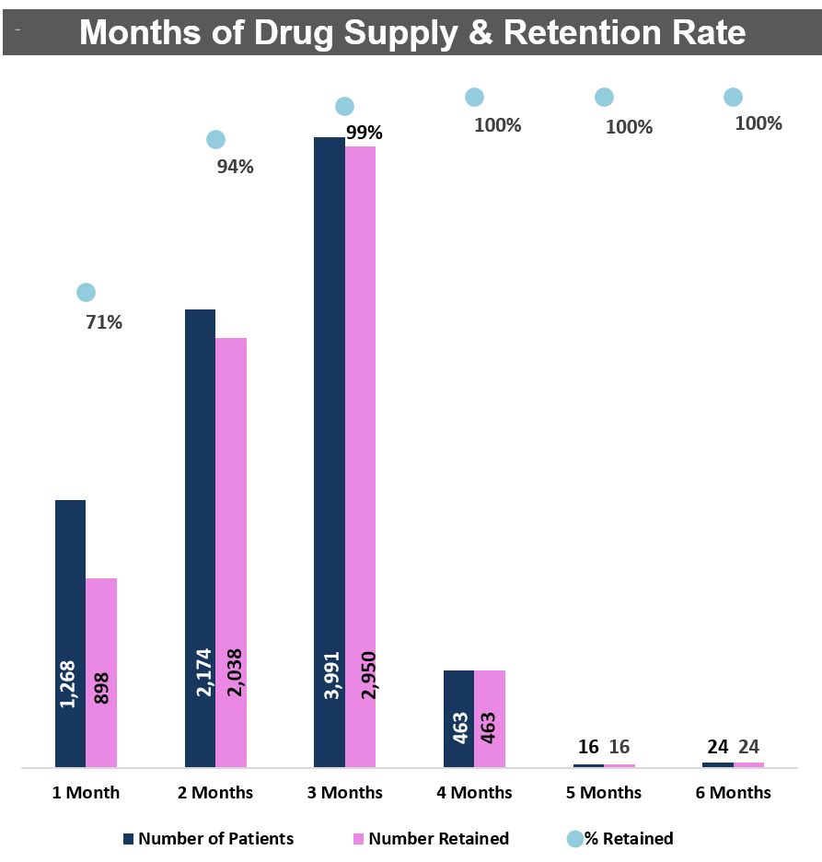
High Treatment Retention Rates Among Patients With Multi-month Antiretroviral Therapy (ART) Supply From HIV Clinic Settings In Nigeria
Juliet Adeola, Patrick Akande, Prosper Okonkwo, Remi Olaitan, Isah Ahmed, Ifeyinwa Onwuatuelo, Toyin Jolayemi
APIN Public Health Initiatives Ltd/Gte., Abuja, Nigeria
Background
Retention on antiretroviral therapy (ART) is a major challenge among HIV-infected patients even with the availability of free and available ART in resource limited settings.
Frequent dispensing of ART place demands on HIV care settings and can lead to suboptimal adherence and retention for patients due to the time and cost of attending frequent clinic visits.
Multi-month drug dispensing has been promoted to reduce the burden of frequent clinic visits for ART refills by the patients.
This study was carried out to determine retention on ART among patients with multi-month supply during their years on ART at five HIV clinics in Nigeria.
Methods
Design:
Retrospective cohort analysis of 6,936 stable, HIV-infected patients age 15 years and older initiated on ART from 2016 – 2018. All patients were followed up in care for at least 12 months after ART initiation.
Setting:
Three Tertiary health institutions (Federal Medical Center Makurdi, University College Hospital – Ibadan & Jos University Teaching Hospital) and two Secondary healthcare facilities (Woma Clinic and Maternity, Adeoyo Maternity Hospital – Ibadan) providing HIV Treatment in Benue, Lagos, Oyo and Plateau State, Nigeria.
These clinics have high patient volumes with more than 32,000 patients currently enrolled on ART.
Participants Selection Criteria:
All HIV-infected patients aged 15years or older, enrolled on ART at the selected clinics and alive during the study period.
Patients were excluded from the study if they are less than 12 months on ART, dead or transferred out.
Data Collection:
Patient demographics and clinical characteristics (Year of ART enrollment, Months of Refill, Type of ART regimen and duration on ART) were obtained from APIN’s electronic Medical Record system.
Main Exposure Variable:
Months of Anti-retroviral Drug (ARV) supply.
Outcome Variable:
Retention On ART
Retention on ART was determined from the electronic pharmacy and clinical encounter visit records.
Retention rates measured among all patients and defined as the proportion of patients alive and on ART at least 12months after ART initiation.
Data Analysis:
Descriptive statistics were calculated to describe patient demographics, clinical characteristics, and retention on ART.
Bivariate analysis was conducted to measure factors strongly associated with retention on ART.
We constructed multivariable logistic regression model to measure associations between patient characteristics and retention on ART.
Results
Of the 6,936 patients on ART, 6,389 (92%) were retained, 4,590 (72%) were female. Duration on ART ranged from 12 – 48 months and mean age was 39years.
In bivariate analysis, factors strongly associated with retention on ART include Sex, Type of ART regimen dispensed (first, second or third line) and months of drug supply.
Patient’s current age, Duration on ART and pregnancy status were not associated with retention after the follow up period.
The likelihood of being retained was six times more (OR= 6.05, 95% CI 5.23 – 6.99) among patients with multi-month drug supply compared with those with one month drug supply after adjusting for other factors in the model.
Conclusion
This study reported that multi-months drug supply promotes retention on ART, further reinforcing the benefits of multi-month drug prescription on ART retention.
Patients on one month supply with good adherence should be given 2-6 months ART supply in order to ease the burden of monthly facility visits on the patients, health care workers and the health system in resource limited settings.
PRESENTED AT THE 23RD INTERNATIONAL AIDS CONFERENCE (AIDS 2020) | 6-10 JULY 2020

